Slide 1
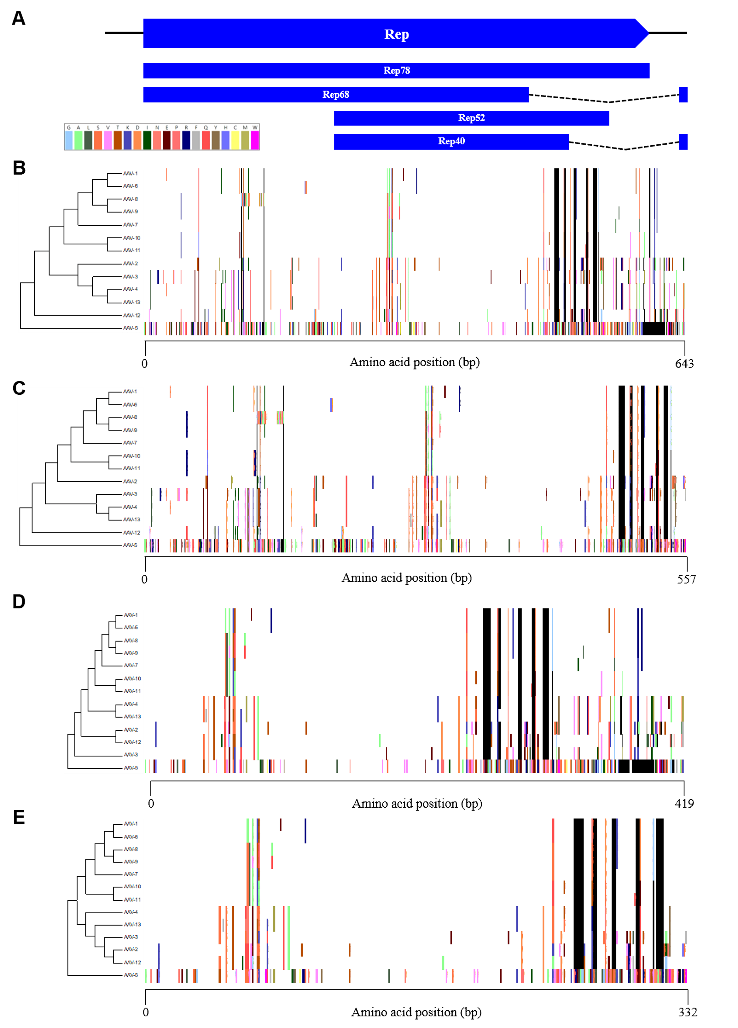
Fig. S1. Proteotyping analysis based on amino acid sequence of 4 transcription units in Rep gene. (A) Graph of proteotyping data. (B) Rep78. (C) Rep68. (D) Rep52. (E) Rep40. Maximum likelihood phylogenetic tree for each protein (Left) is shown. The color assigned to each amino acid is indicated top. The blank and consensus sequence are represented in black and white, respectively.

