Slide 1
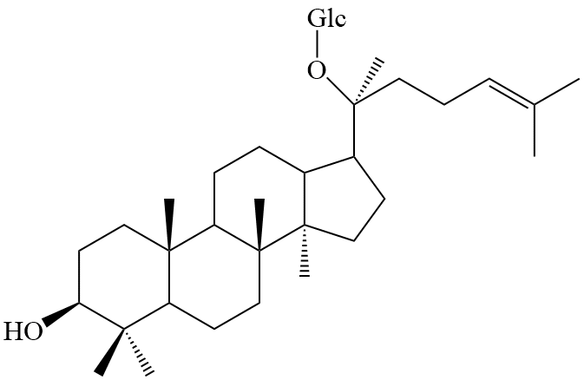
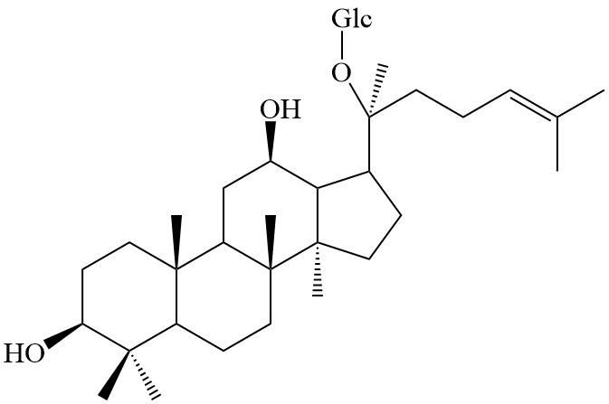
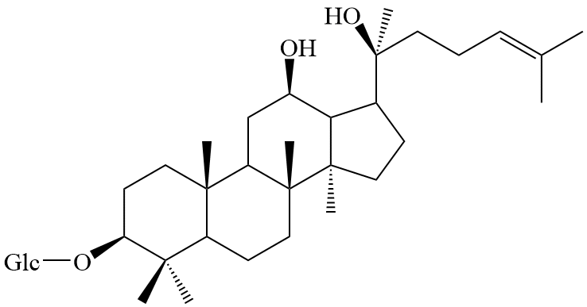
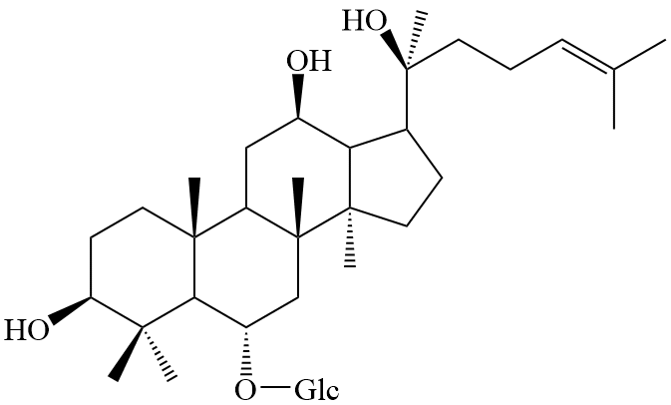
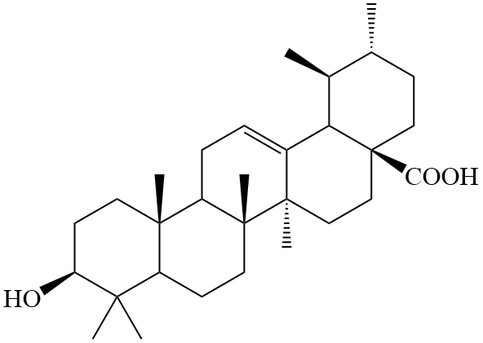
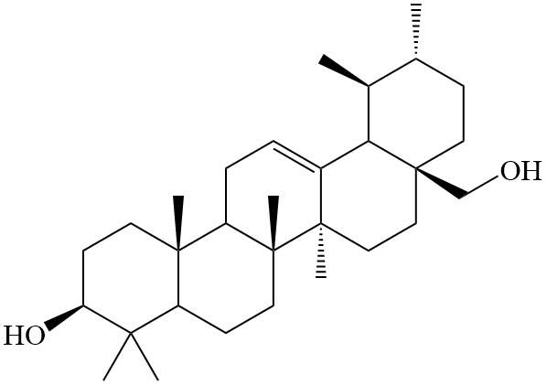
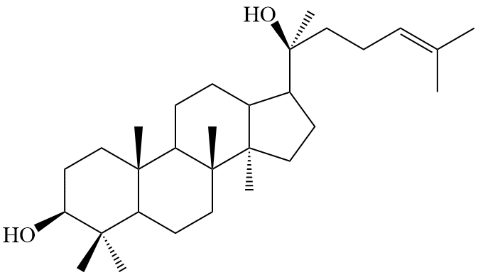
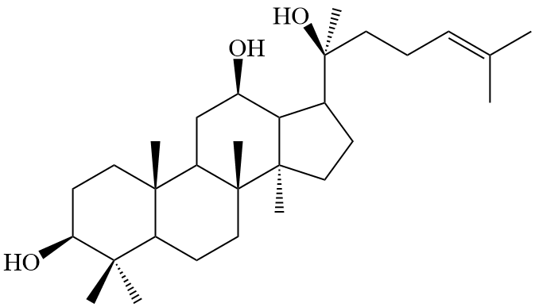
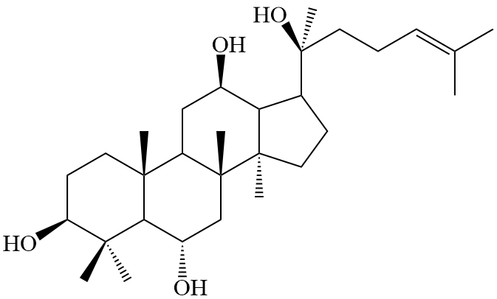
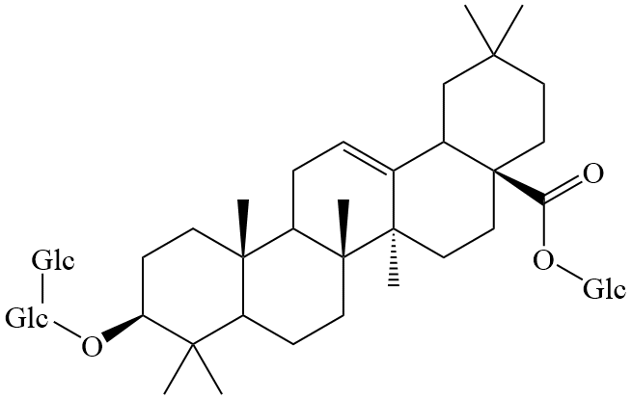
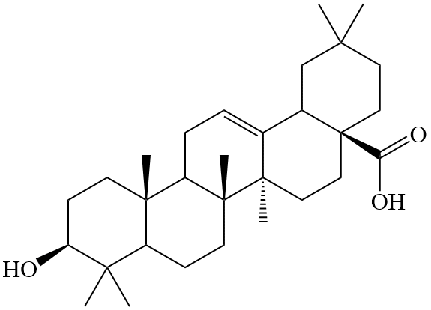
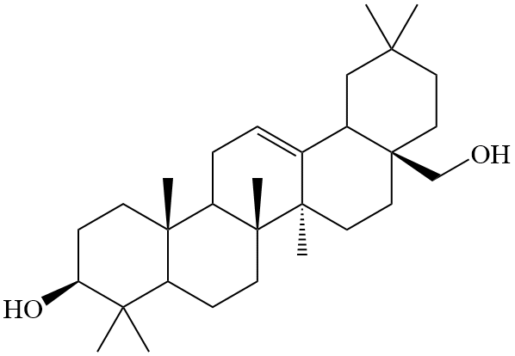
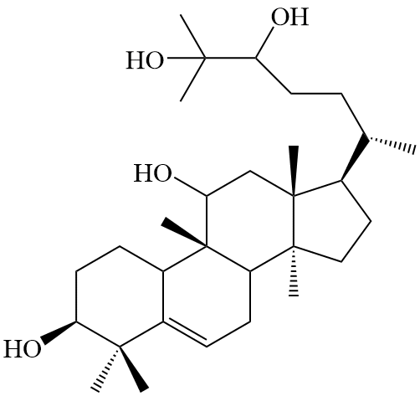
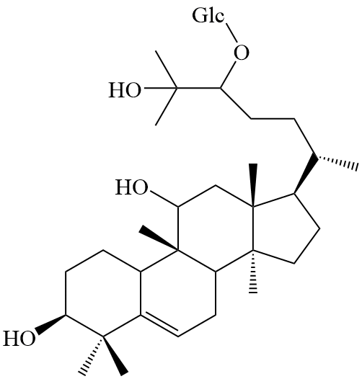
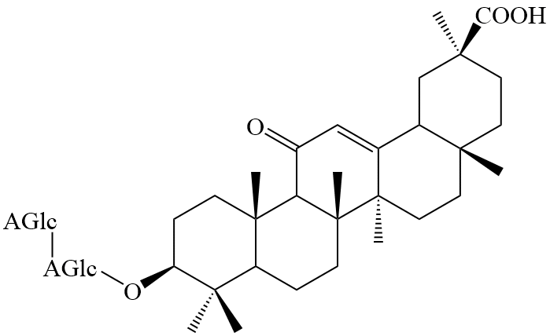
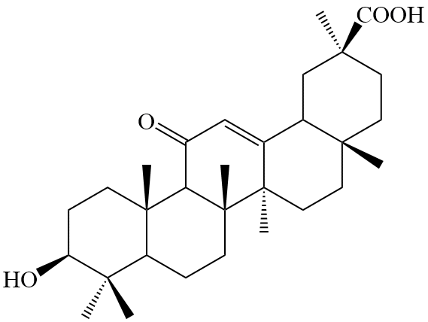
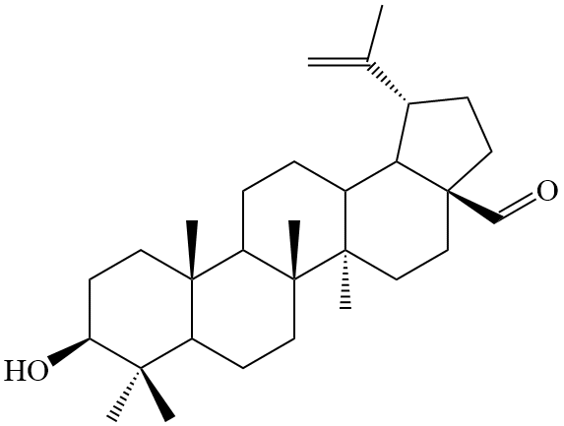
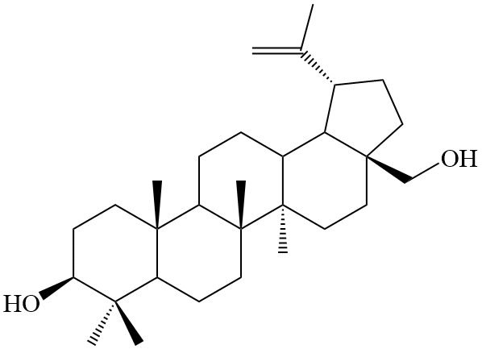
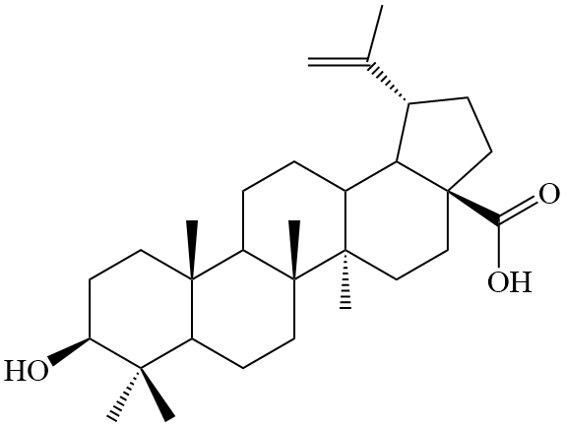
Fig. S2.
CYP/CPR
DMG
ginsenoside CK
ginsenoside Rh2
ginsenoside Rh1
UGT
UGT
UGT
UGT
CYP/CPR
lanosterol
ursolic acid
uvaol
thalianol
CYP/CPR
CYP/CPR
THAS
LAS
UGT
CYP/CPR
AAS
protopanaxadiol
α-amyrin
dammarenediol Ⅱ
protopanaxatriol
DDS
CYP/CPR
ginsenoside RO
olenolic acid
erythrodiol
BAS
CDS
CYP/CPR
UGT
CYP/CPR
β-amyrin
2,3-oxidosqualene
LUP
CYP/CPR
MRN
CAS
cucurbitadienol
mogrol
mogrosides
glycyrrhizic acid
glycyrrhetinic acid
CYP/CPR
CYP/CPR
CYP/CPR
lupeol
marneral
cycloartenol
betulinic aldehyde
betulin
Betulinc acid

